Slide 1
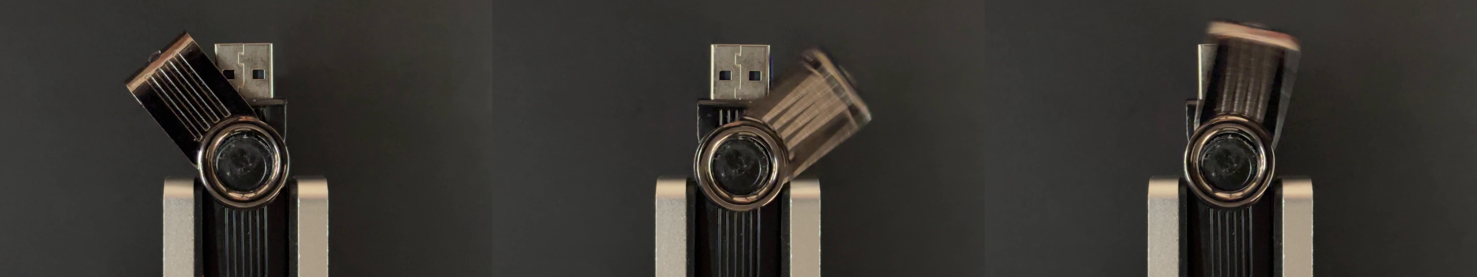

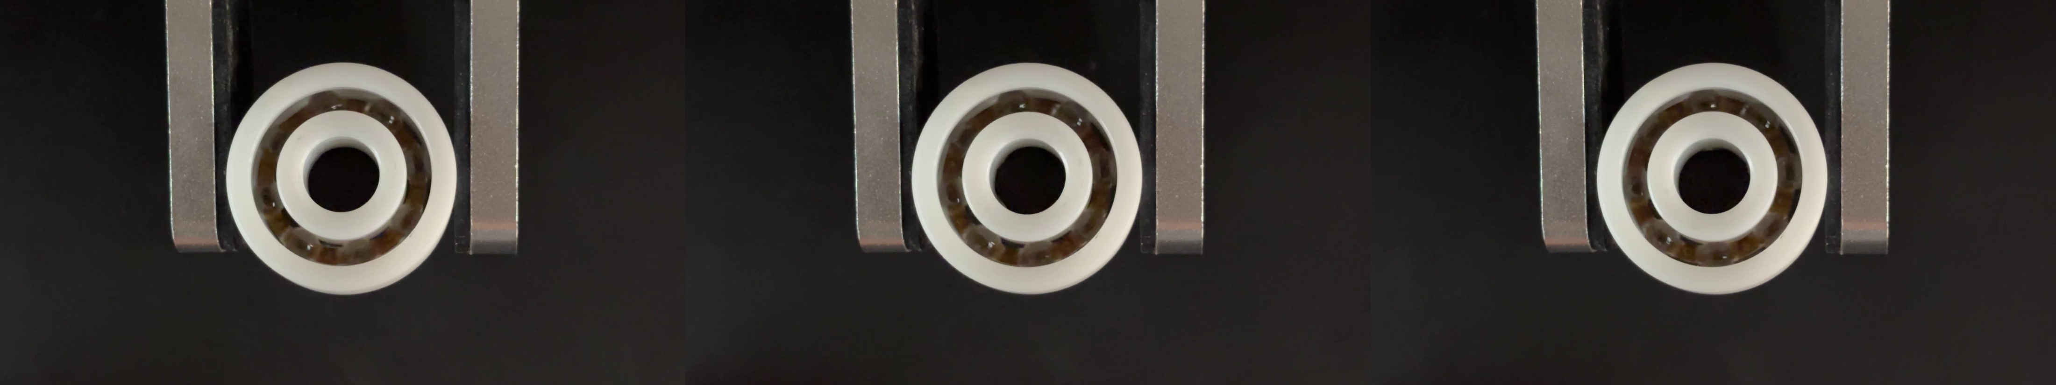
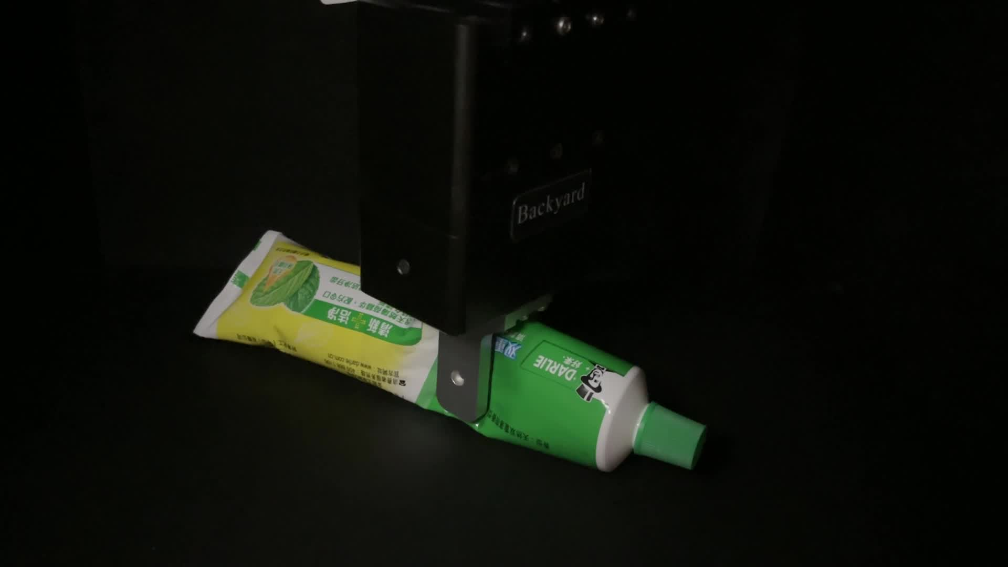
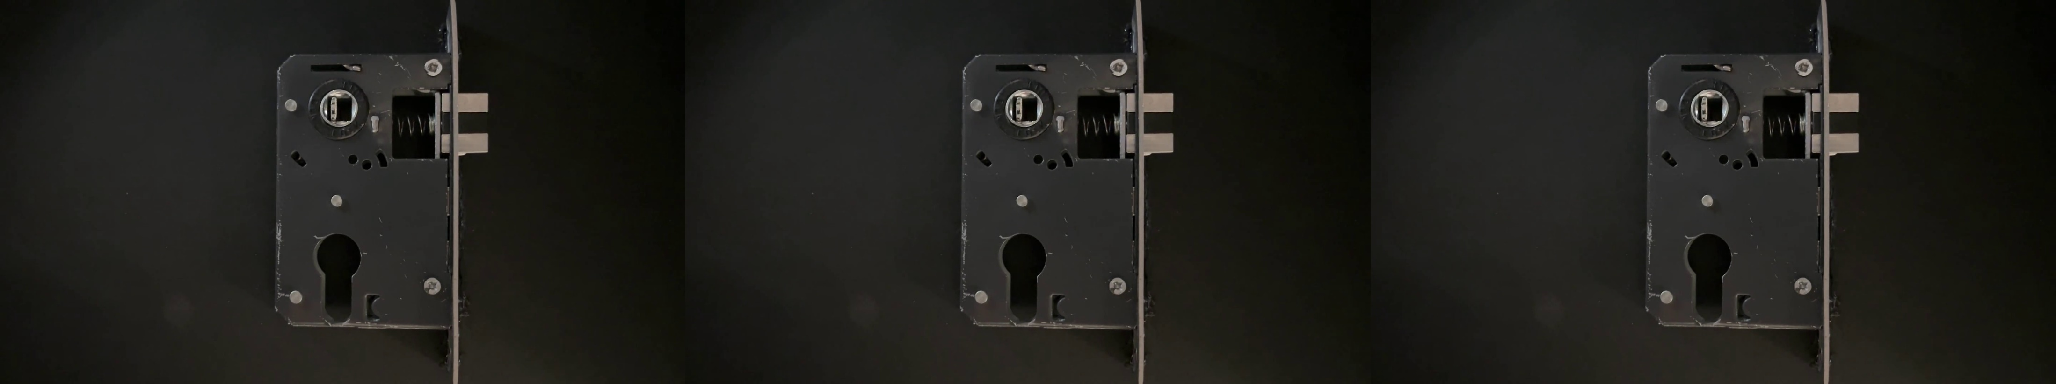
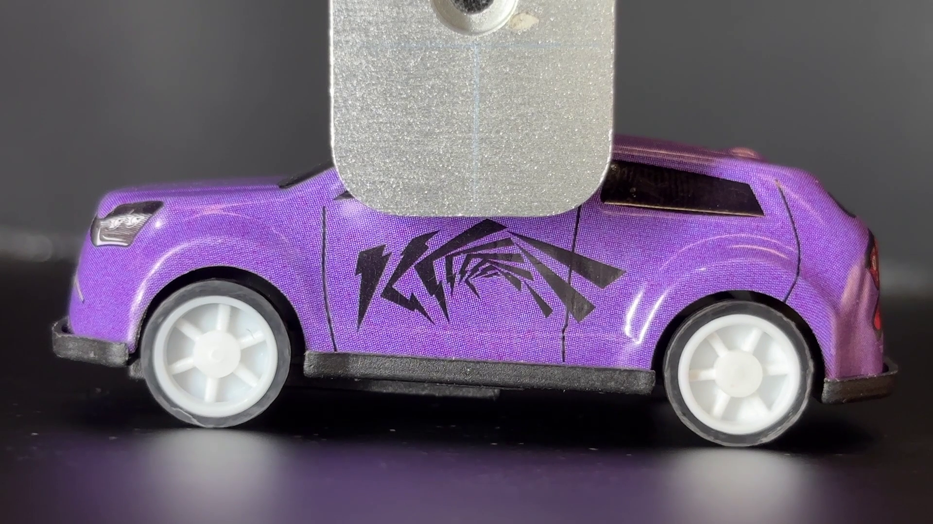
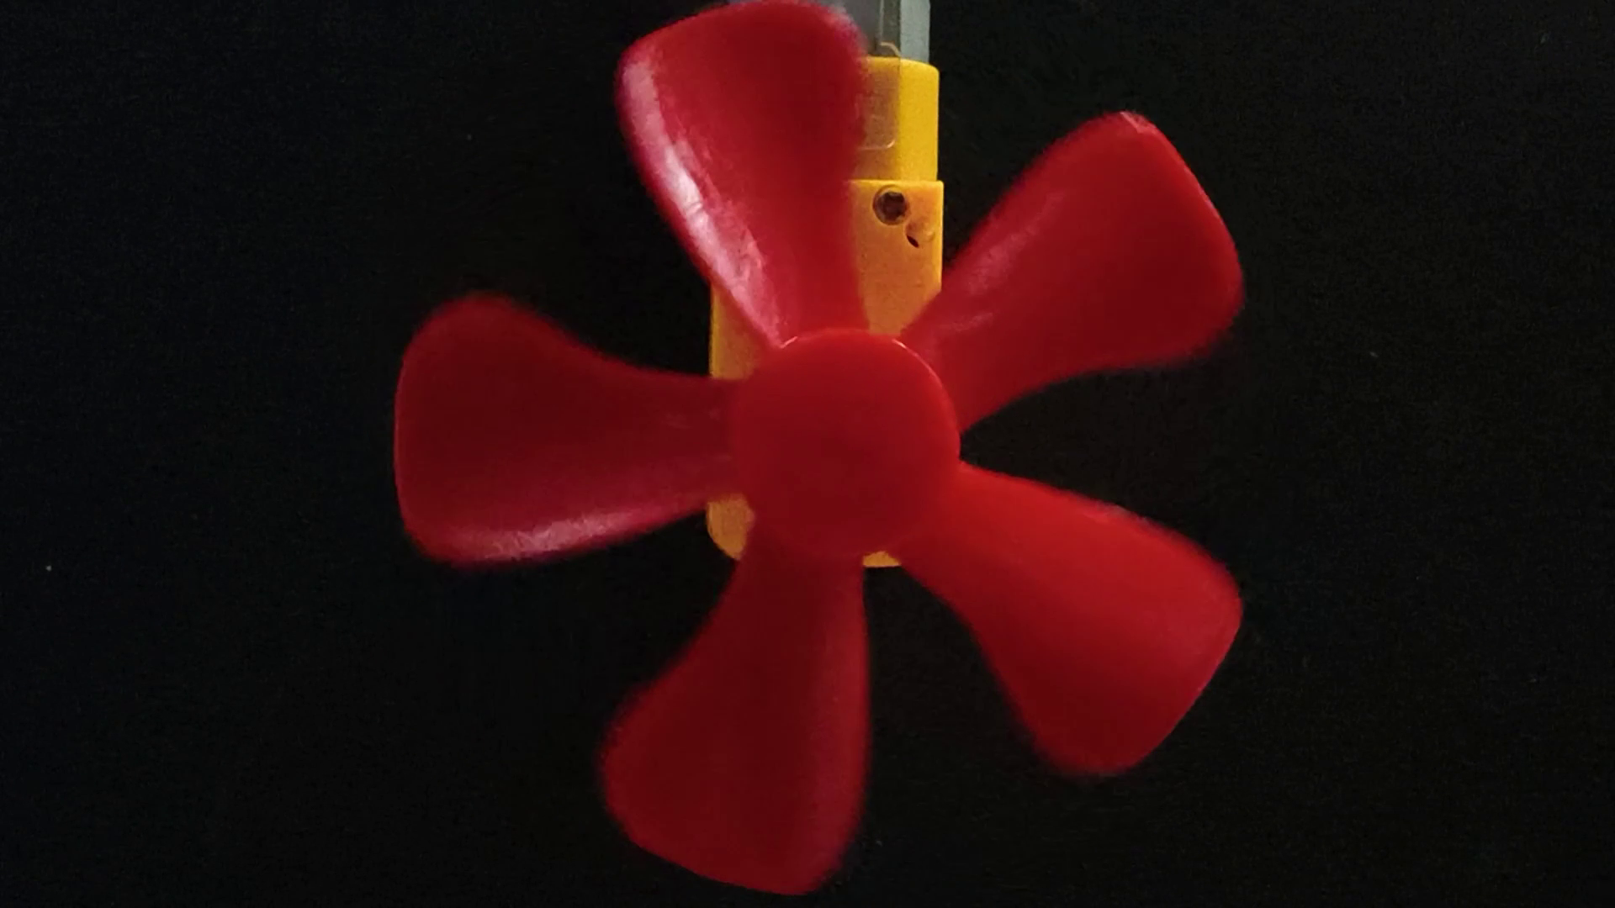
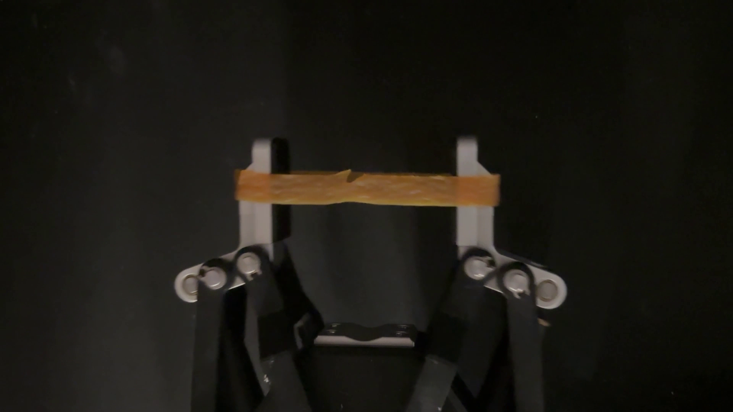
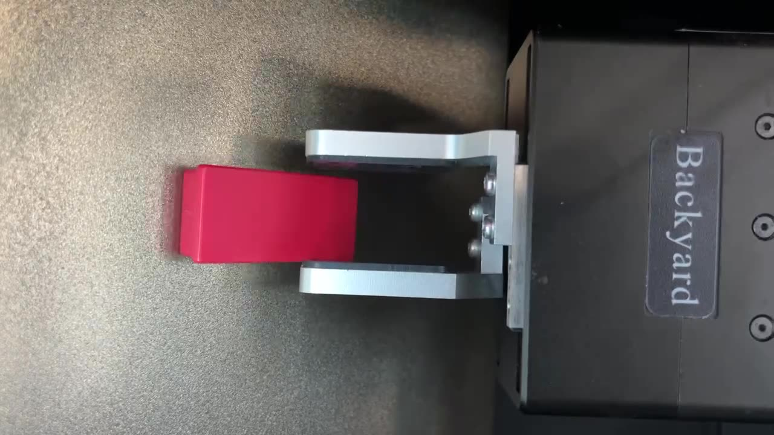
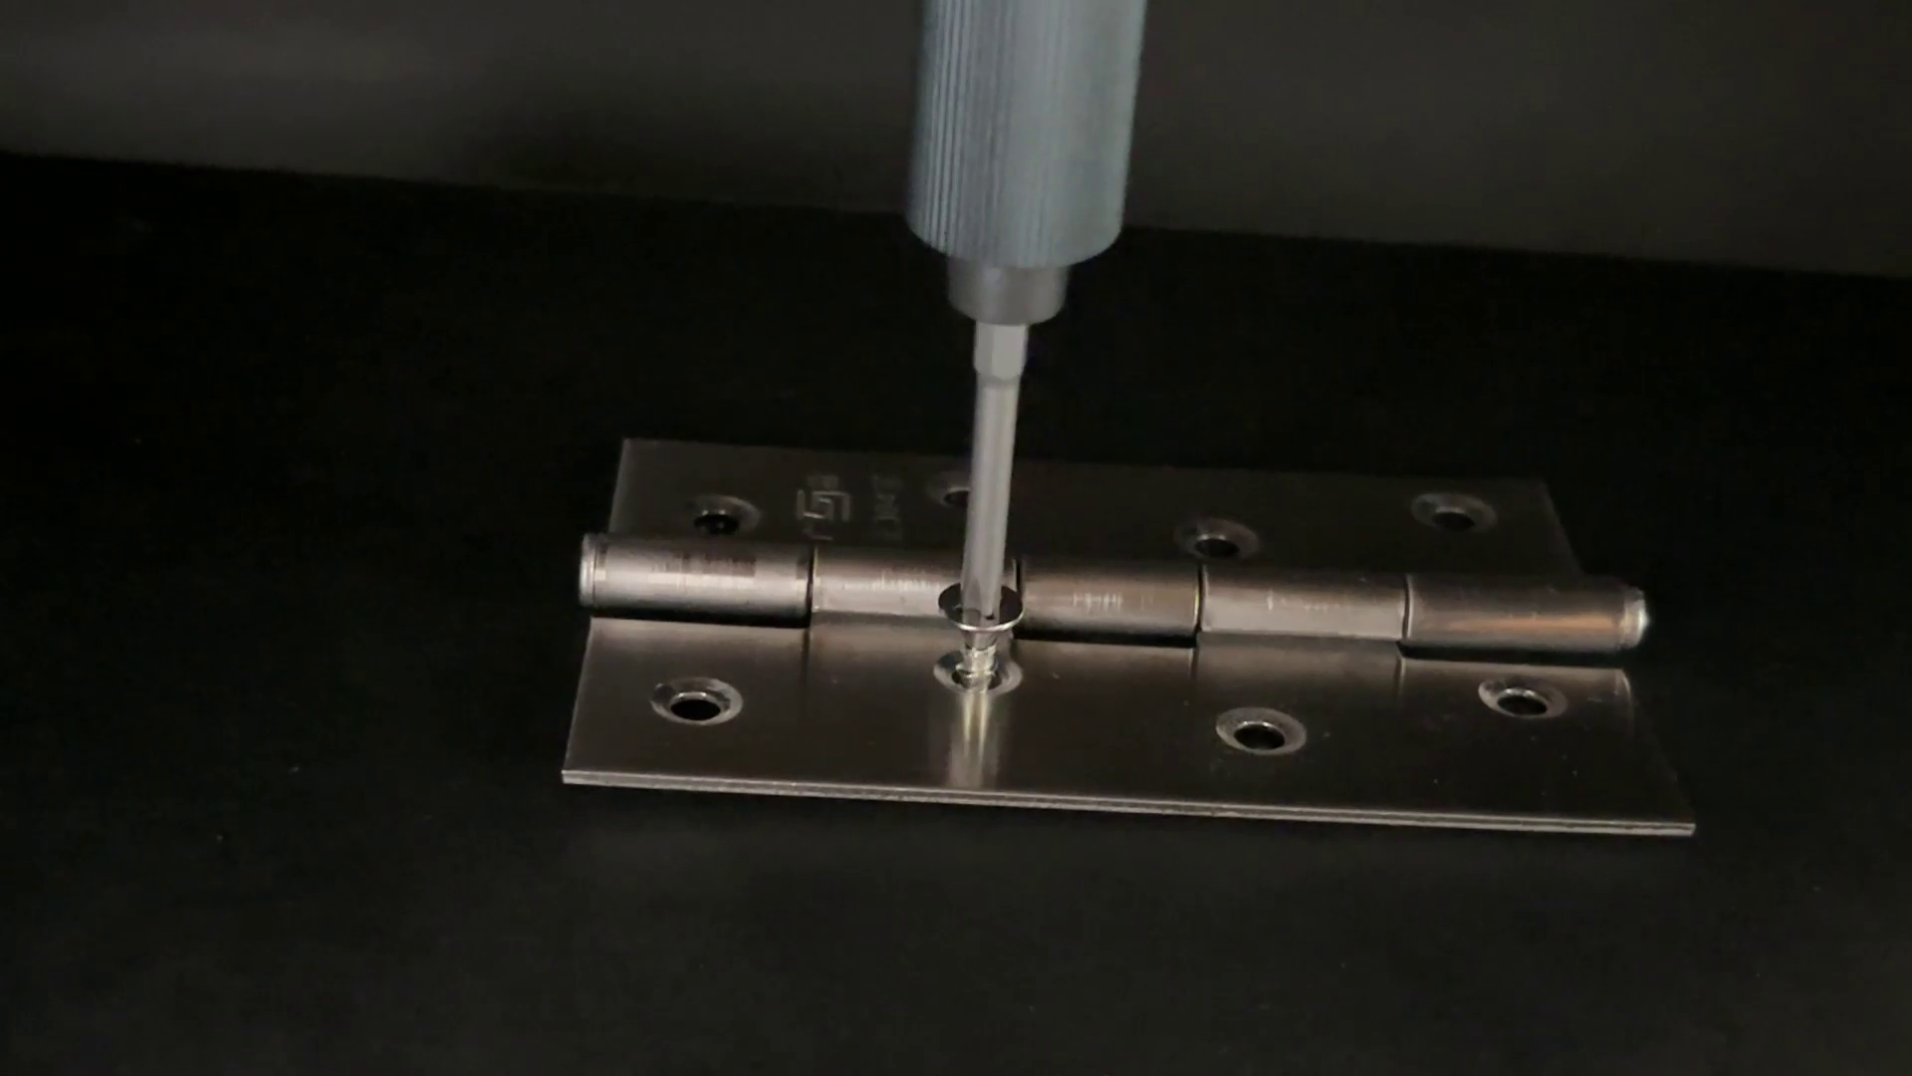
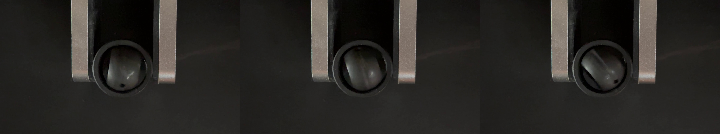
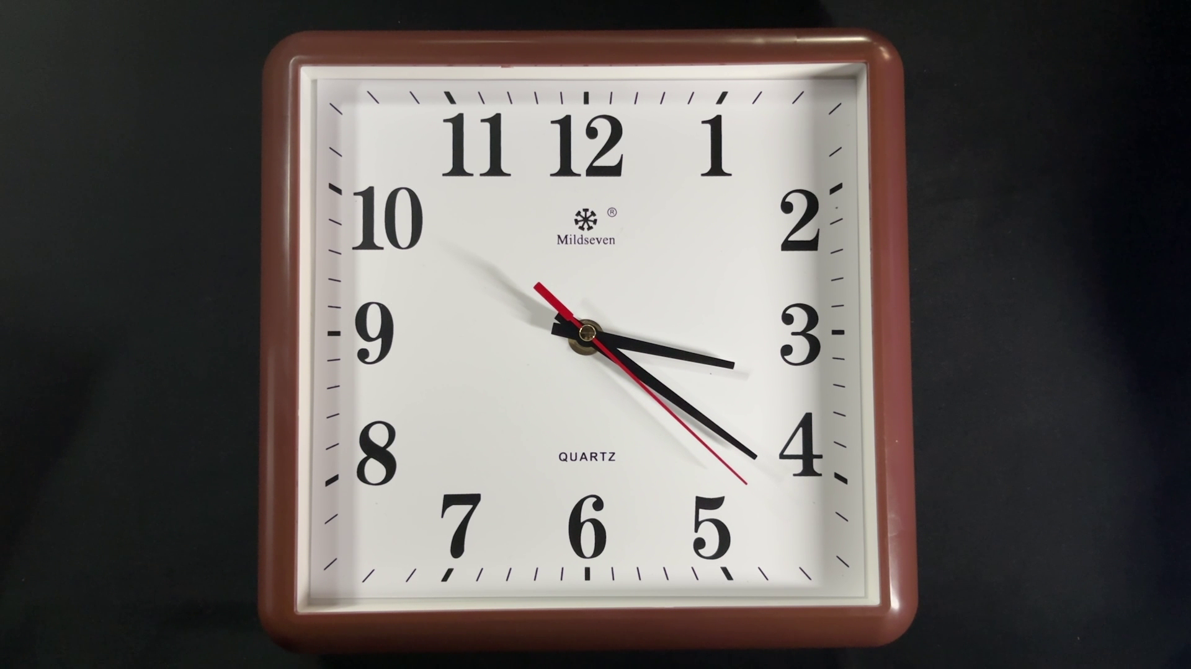
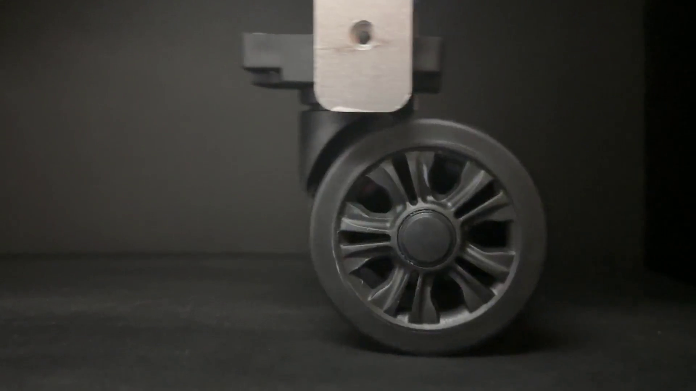
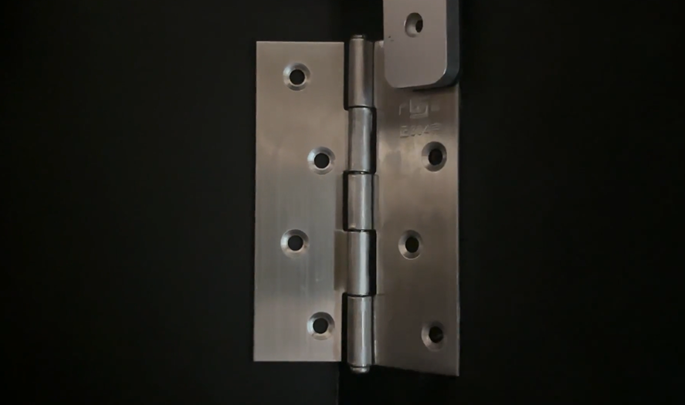
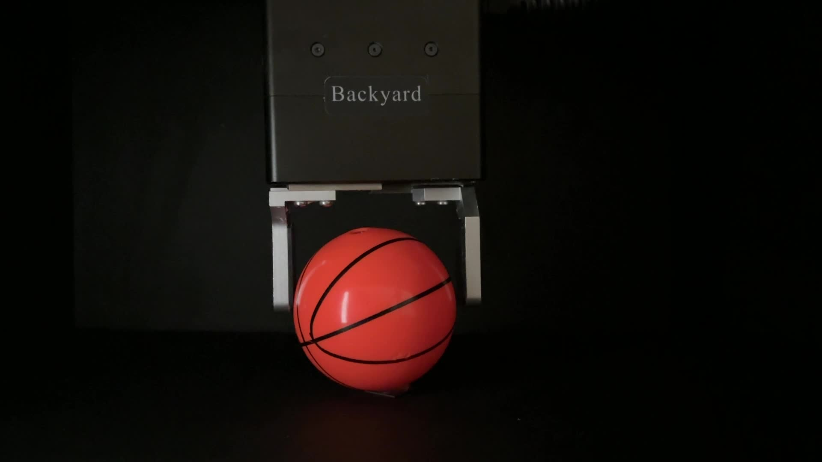
U Disk
Zipper
Rolling Bearing
Sticky Roller
Slider
Toothpaste
Door Lock
Toy Car
Clip
Fan
Rubber Band
Magnet
Motion
Direction
For Interaction
Servo
Gear Assembly
Bottled Water
Screw
Spherical Bearing
Interaction
Axis
Button
Clock
Caster Wheel
Hinge
Ball

Slide 2
Index | Object | Number of training videos | Number of testing videos |  | Types of object | Types of abnormalities | Frames of a single video
 |  |  | Normal | Abnormal
1 | Ball | 90 | 45 | 90 | 3 | 2 | 240
2 | Button | 120 | 60 | 240 | 4 | 4 | 180
3 | Car | 300 | 150 | 450 | 5 | 3 | 60
4 | Caster wheel | 30 | 15 | 45 | 1 | 2 | 180
5 | Clip | 240 | 120 | 240 | 4 | 2 | 120
6 | Clock | 150 | 74 | 150 | 5 | 2 | 180
7 | Fan | 180 | 90 | 270 | 3 | 3 | 180
8 | Gear | 180 | 90 | 360 | 3 | 4 | 120
9 | Hinge | 30 | 15 | 45 | 1 | 2 | 120
10 | Liquid | 30 | 15 | 30 | 1 | 2 | 180
11 | Lock | 120 | 60 | 120 | 1 | 2 | 60
12 | Magnet | 30 | 15 | 30 | 1 | 2 | 180
13 | Roller | 30 | 15 | 30 | 1 | 2 | 180
14 | Rolling bearing | 60 | 30 | 30 | 1 | 1 | 60
15 | Rubber | 60 | 30 | 30 | 1 | 1 | 180
16 | Screw | 30 | 15 | 30 | 1 | 2 | 180
17 | Servo | 120 | 60 | 180 | 1 | 3 | 120
18 | Slide | 60 | 30 | 120 | 1 | 3 | 120
19 | Spherical bearing | 60 | 30 | 30 | 1 | 1 | 60
20 | Toothpaste | 90 | 45 | 45 | 3 | 1 | 180
21 | U-disk | 240 | 120 | 120 | 4 | 1 | 60
22 | Zipper | 120 | 60 | 120 | 2 | 2 | 120
 | Total videos： | 2370 | 3989
 | Total frames： | 293400 | 502920

